Slide 1
Database Management System
Relational Model
Mahmudul Hasan
Lecturer
Dept of CSE
UIU

Slide 2
Relational Model Concepts
2
The relational model represents the database as a collection of relations/tables.
When a relation is thought of as a table of values, each row in the table represents a collection of related data values. A row represents a real-world entity or relationship.
The table name and column names are used to help to interpret the meaning of the values in each row.

Slide 3
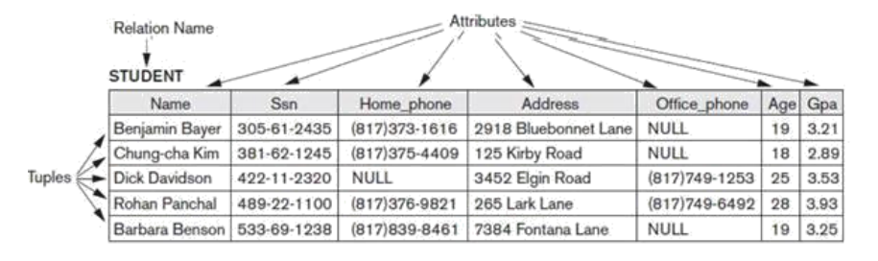
Relational Model Concepts
2
In the formal relational model terminology,
a row is called a tuple,
a column header is called an attribute,
the table is called a relation.
The data type describing the types of values that can appear in each column is represented by a domain of possible values.

Slide 4
Domains, Attributes, Tuples, and Relations
2
The set of allowed values for each attribute is called the domain of the attribute.
Some examples of domains follow:
BD_phone_numbers: The set of 11-difgit phone numbers valid in BD.
Employee_ages: Possible ages of employees in a company; each must be an integer value between 15 and 80.
Attribute values are (normally) required to be atomic; that is, single and indivisible. E.g. the value of an attribute can be an account number but cannot be a set of account numbers. Full name attribute can be split into first name , last name to ensure atomicity.
The special value null is a member of every domain. Indicated that the value is “unknown”

Slide 5
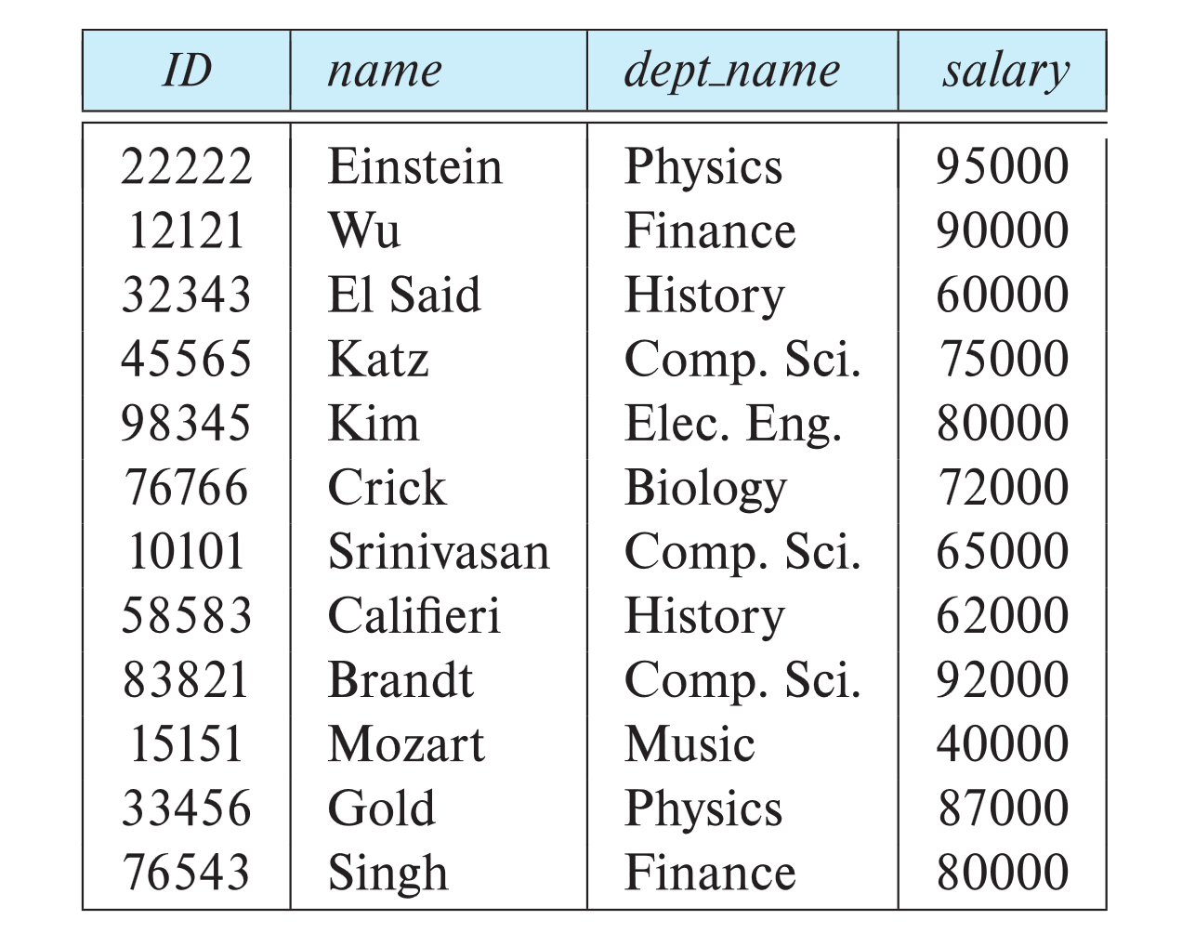
Relations are Unordered
2
Order of tuples is irrelevant (tuples may be stored in an arbitrary order)
Example: instructor relation with unordered tuples

Slide 6
Relation Schema
2
A relation schema R,
R = (A₁, A₂, …, A_{n} ) is a relation schema where A₁, A₂, …, A_{n} are attributes
Example:
instructor = (ID, name, dept_name, salary)
Customer_schema = (customer_name, customer_street, customer_city)
A relation instance r defined over schema R is denoted by r (R).
Example:
customer (Customer_schema)
The current values of a relation are specified by a table
An element t of relation r is called a tuple and is represented by a row in a table

Slide 7
Database
2
A database consists of multiple relations
Information about an enterprise is broken up into parts, with each relation storing one part of the information
account: stores information about accounts depositor : stores information about which customer owns which account customer : stores information about customers
Storing all information as a single relation such as bank(account_number, balance, customer_name, ..) results in repetition of information e.g.,if one customer owns several accounts (What gets repeated?)
the need for null values e.g., to represent a customer without an account
Normalization theory deals with how to design relational schemas

Slide 8
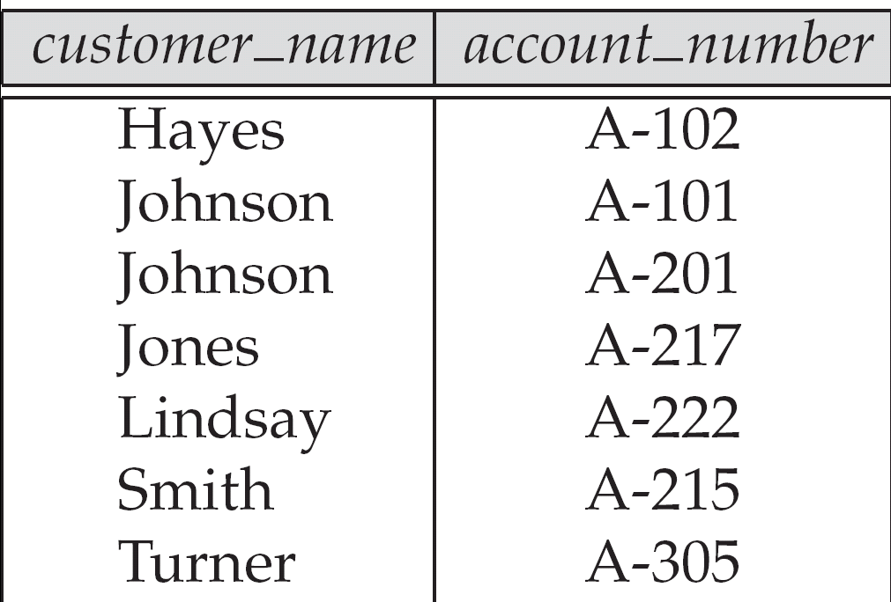
Database
2

Slide 9
Key Constraints and Constraints on NULL Values
2
A key is a set of one or more attributes that can uniquely identify each row in a table. A key not only identifies the rows of a table but also relates two or more tables.
Different Types of Keys:
1) Super Key
2) Candidate Key
3) Primary Key
4) Foreign Key
5) Secondary Key/Alternate Key
6) Unique Key
7) Composite Key
8) Surrogate Key
9) Partial Key

Slide 10
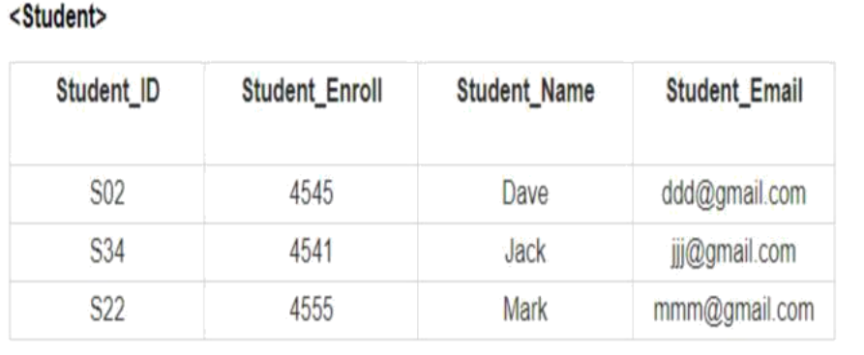
Key Constraints – Super Key
2
K is a superkey of R if values for K are sufficient to identify a unique tuple of each possible relation r(R) .

Slide 11
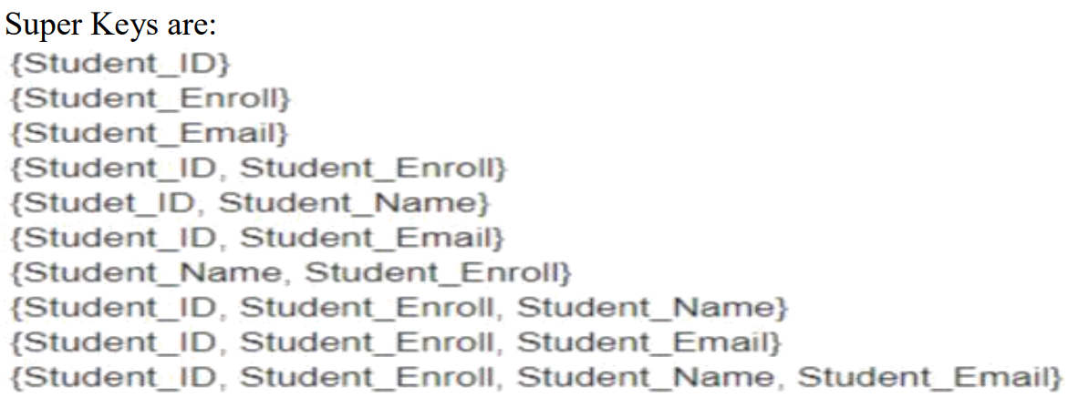
Key Constraints – Super Key
2
K is a superkey of R if values for K are sufficient to identify a unique tuple of each possible relation r(R) .

Slide 12
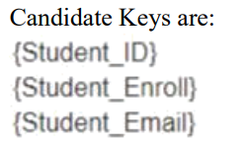
Key Constraints – Candidate Key
2
Superkey K is a candidate key if K is minimal

Slide 13
Key Constraints – Primary Key
2
One of the candidate keys is selected to be the primary key.
Which one?
Should choose an attribute whose value never, or very rarely, changes.
E.g. email address is unique, but may change
The main difference between the primary key and the candidate key is that primary key does not contain NULL values.
✓ Primary Key must be UNIQUE and NOT NULL.

Slide 14
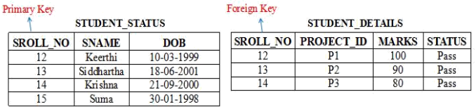
Key Constraints – Foreign Key
2
A foreign key is a set of attributes in a table that refers to the primary key of another table.
Only values occurring in the primary key attribute of the referenced relation may occur in the foreign key attribute of the referencing relation.

Slide 15
Key Constraints – Unique Key
2
A Unique Key is used to prevent duplicate values in a column.
A primary key cannot accept NULL values; this makes Primary Key different from unique Key, since Unique Key allows one value as NULL value.
A table can only have a single Primary Key, whereas a Unique Key can be more than
one if you need it in the table.
Unique Key ensures that data is not duplicated in two rows in the database. A row in the database can have null in case of Unique Key.
You cannot modify a Primary Key, but a Unique Key can be modified.

Slide 16
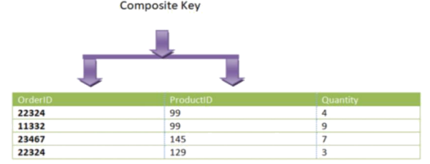
Key Constraints – Composite Key
2
A primary key having two or more attributes is called composite key. It is a combination of two or more columns
Example 1: Here our composite key is OrderID and ProductID −
{OrderID, ProductID}

Slide 17
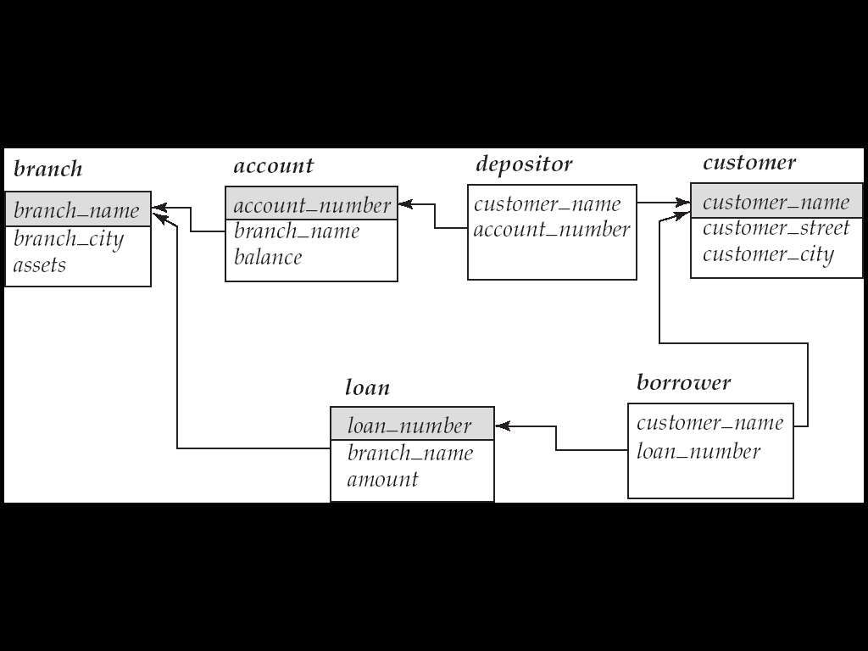
Relational Database Schemas
2
Relational database schema S is a set of relation schemas S = {R1, R2, ..., Rm} and a s et of integrity constraints.

Slide 18
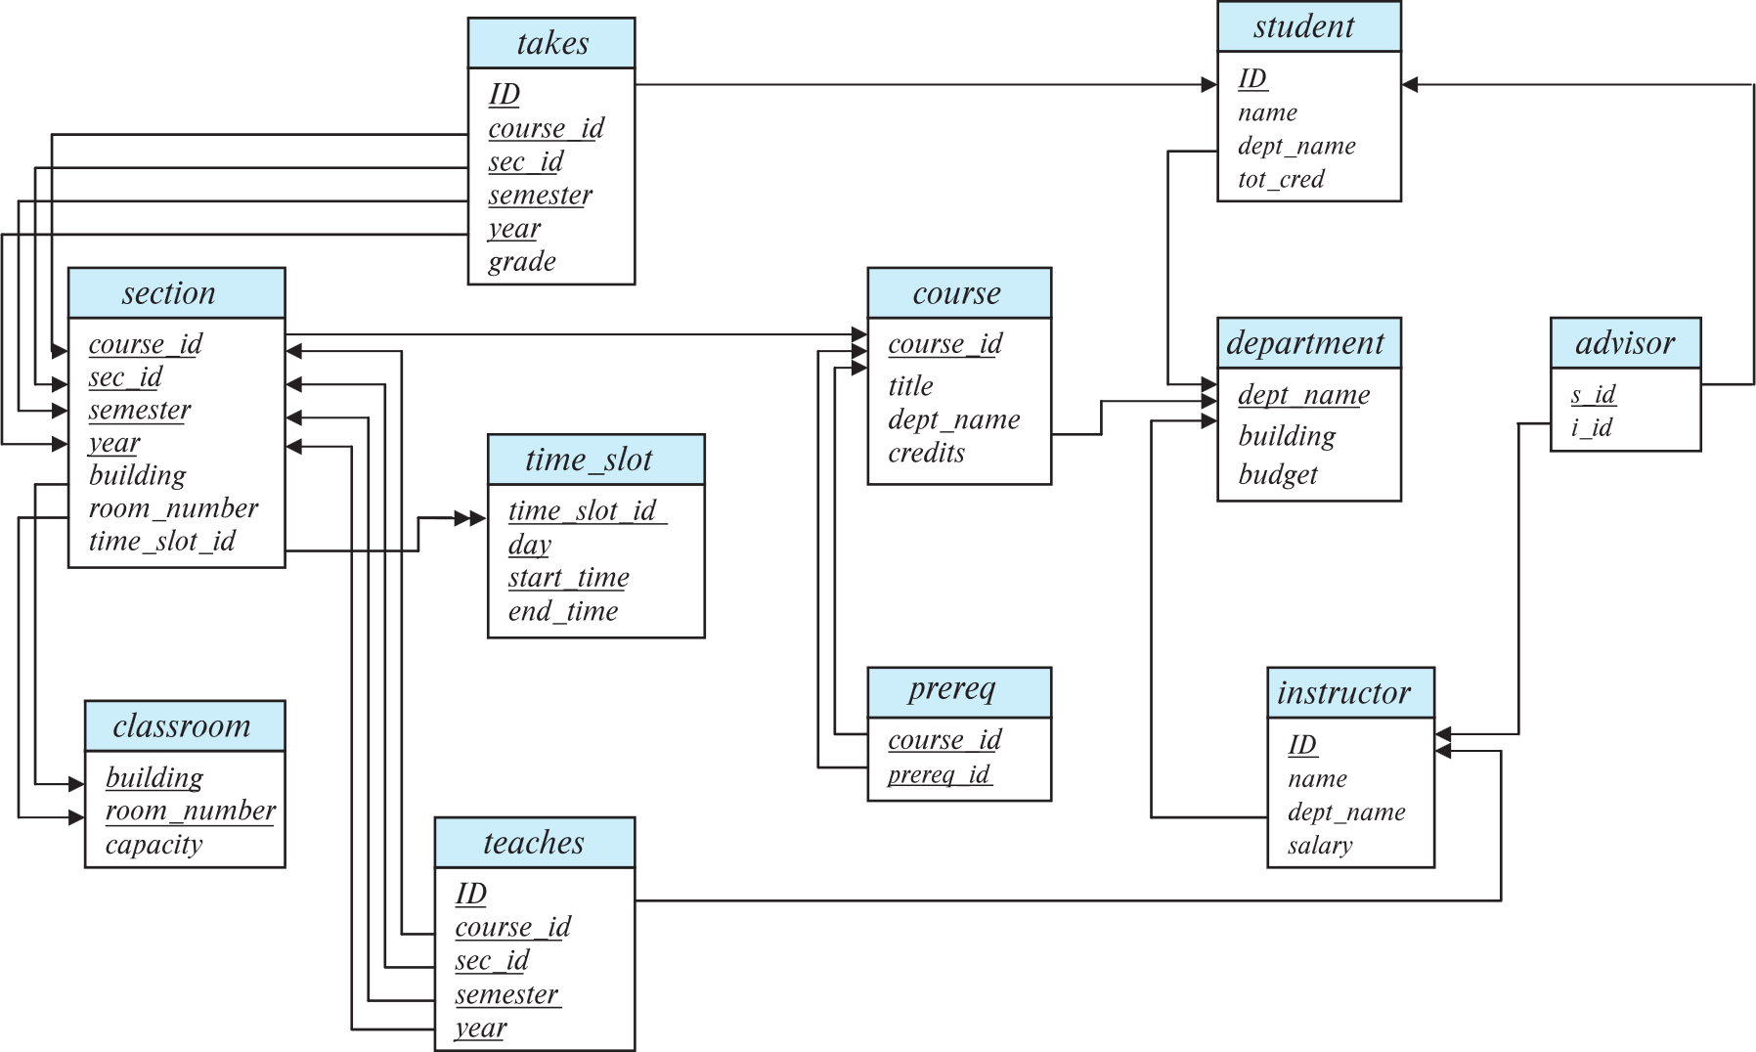
Relational Database Schemas
2

Slide 19
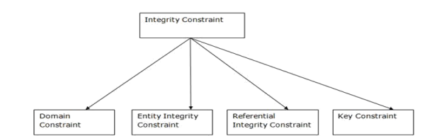
Integrity, Referential Integrity, and Foreign Keys
2

Slide 20
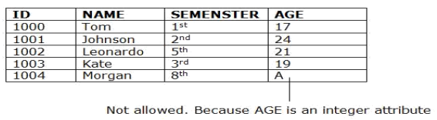
Integrity, Referential Integrity, and Foreign Keys
2
Domain Constraints:
✓ Domain constraints can be defined as the definition of a valid set of values for an
attribute.
✓ The data type of domain includes string, character, integer, time, date, currency, etc. The value of the attribute must be available in the corresponding domain.

Slide 21
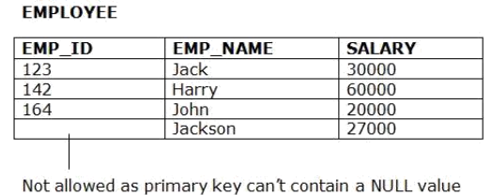
Integrity, Referential Integrity, and Foreign Keys
2
Entity integrity constraints
✓ The entity integrity constraint states that primary key value can't be null.
✓ This is because the primary key value is used to identify individual rows in relation and if
the primary key has a null value, then we can't identify those rows.
✓ A table can contain a null value other than the primary key field

Slide 22
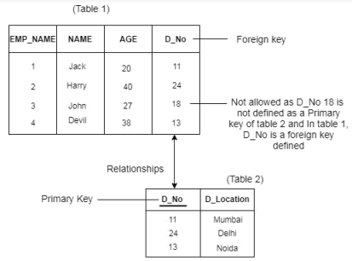
Integrity, Referential Integrity Constraints
2
Referential Integrity Constraints
✓ A referential integrity constraint is specified between two tables.
✓ In the Referential integrity constraints, if a foreign key in Table 1 refers to the
Primary Key of Table 2, then every value of the Foreign Key in Table 1 must be null or be available in Table 2

Slide 23
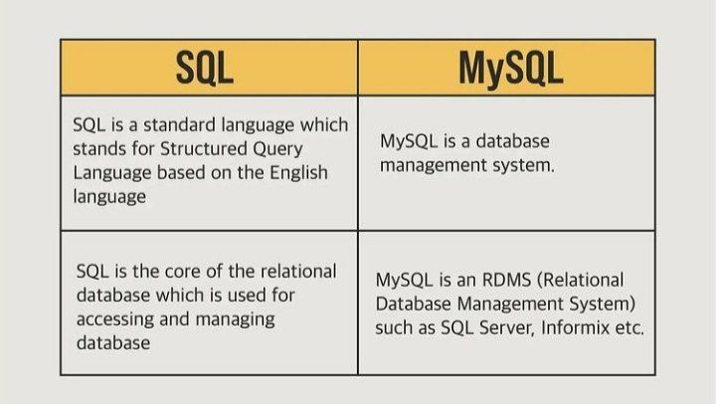
SQL vs MYSQL
20

Slide 24
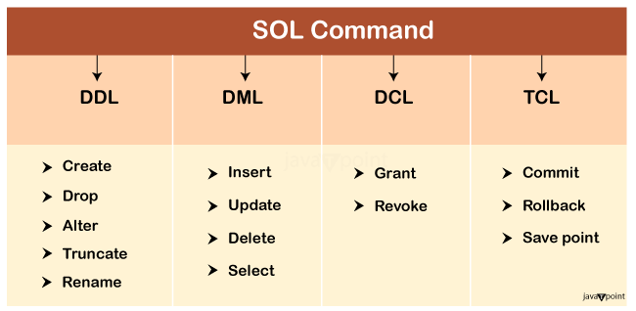
SQL Commands
20

Slide 25
Table
20
A table is an organized arrangement of data and information in the tabular form containing rows and columns, making it easier to understand and compare data
Columns/ Fields / Attributes
ID | Student Name | Age
1 | A | 21
2 | B | 22
3 | C | 22
4 | D | 23
Rows/Records

Slide 26

Database
20
A database is a large collection of data or information, specifically, a large collection of tables organized in a way in which it can be easily updated or accessed with a computer system

Slide 27
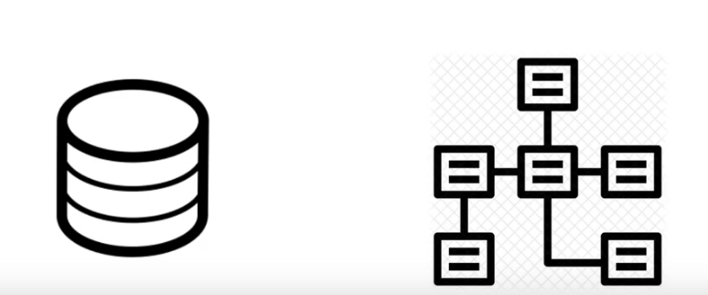
Relational Database
20

Slide 28
Relational Database
20
Student
student_id | name | age
1 | ABC | 25
2 | DEF | 20
3 | GHI | 22
4 | JKL | 27
Course
course_id | name | faculty
1 | Java | X
2 | Python | Y
3 | CPP | W
4 | JS | M
Student_Course
student_id | course_Id | marks
1 | 4 | 85
1 | 3 | 90
2 | 3 | 70
4 | 2 | 67

Slide 29
Primary Key
20
A primary key is a field in a table which uniquely identifies each row/record in a database table.
Primary keys must contain UNIQUE values
cannot contain NULL values.
Primary key can NOT BE DUPLICATE
A table can have only ONE primary key; and in the table, this primary key can consist of single or multiple columns (fields).

Slide 30
Primary Key - Example
20
Student
ID | Student Name | Age
1 | A | 21
2 | B | 22
3 | C | 22
4 | D | 23
Primary key

Slide 31
Foreign key
20
A FOREIGN KEY is a field (or collection of fields) in one table, that refers to the PRIMARY KEY in another table.
A foreign key is a key used to link two tables together
Foreign key also called referencing key
Foreign key CAN BE DUPLICATE
To create foreign key, primary key of another table must be created FIRST.

Slide 32
Foreign key - Example
20
Student Table
ID | Student Name | Age | Course
1 | A | 21 | CSE 3522
2 | B | 22 | CSE 1110
3 | C | 22 | CSE 3522
4 | D | 23 | CSI 212
Course Code | Course Name | Credit
CSE 3522 | DBMS Lab | 1
CSE 1110 | Intro To CS | 3
CSE 212 | OOP Lab | 1
Foreign key
Primary key

Slide 33
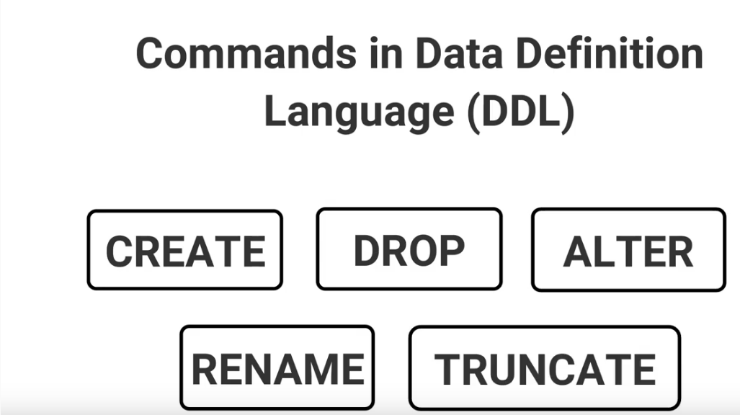
SQL Commands Cont’d
20
A DDL is a SQL (Structured Query Language) command which is used to create and modify the structure of database objects in a database. Also known as Data Description language.

Slide 34
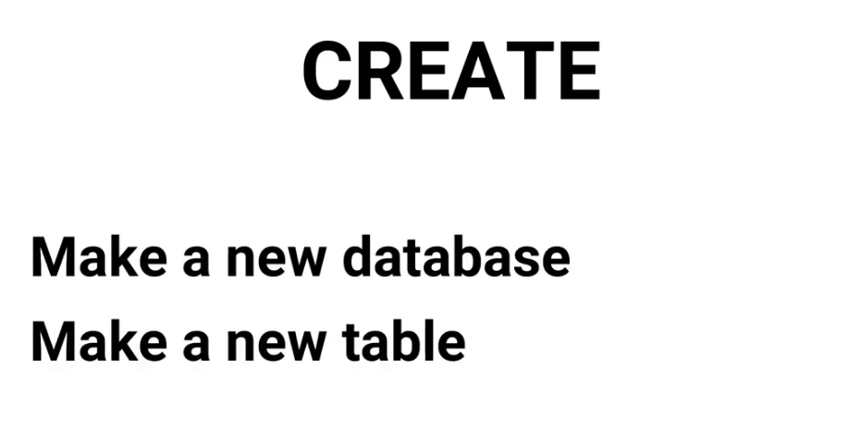
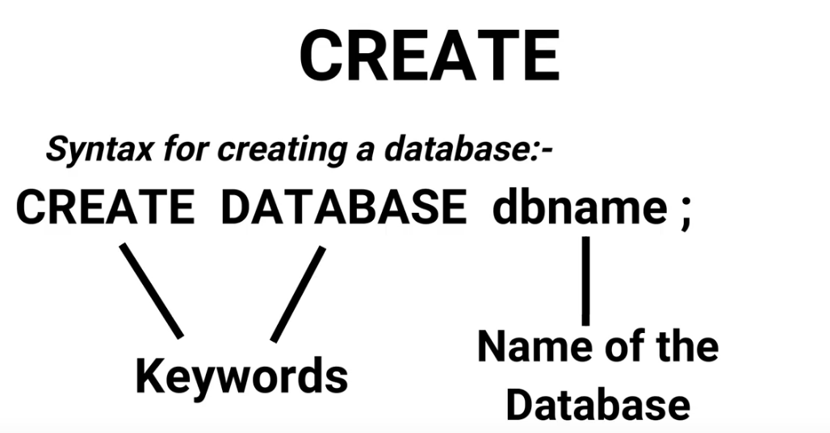
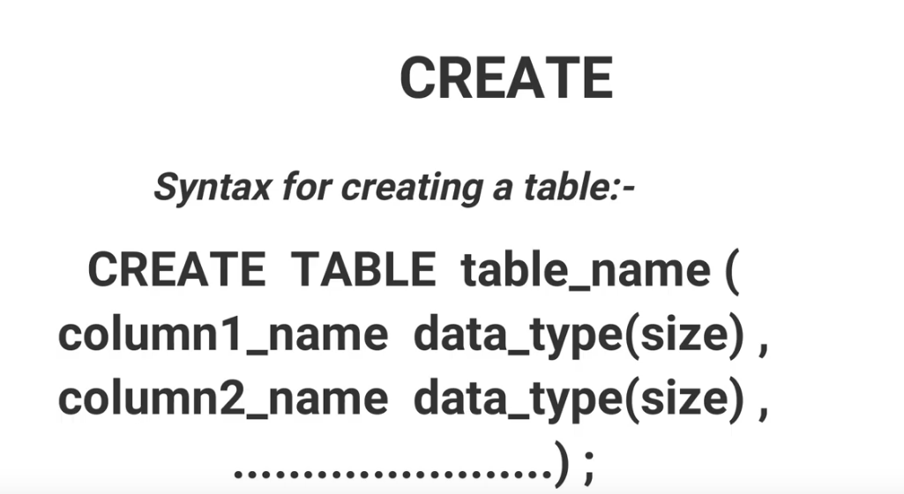
DDL Command -create
20

Slide 35
Common DATA TYPES
20
Keywords | Datatypes | Example
INT | Whole number | 1, 2., 172
FLOAT | Fraction number | 3.1416
VARCHAR (x) | string | “CSE 3522”, “EEE”
DATE | Date (YYYY-MM-DD) | 2021-07-10

Slide 36
DDl Command – Alter TABLE
20
Create a database:
CREATE DATABASE <database_name>;
Example: CREATE DATABASE university;
Create a table inside a database: (Click on the database in which you want create a table, then in SQL editor)
CREATE TABLE <table_name> (
<attribute1> <datatype>(<size>),
<attribute2> <datatype>(<size>),
.......................,
<constraint1> <constraint name> <constraint parameter>,
<constraint2> <constraint name> <constraint parameter>,
......................................................
);

Slide 37
DDl Command – Alter TABLE
20
Alter commands are used when we want to modify or change the filed or column related stuff of a table after they have been already created. In other words, ALTER commands works on the existing table set.
ADD a newcolumn to an existing table
ALTER TABLE <table_name> ADD COLUMN <column_name> <data_type> (<size>)
Example: add a column “Email” to the student table
ALTER TABLE student ADD column Email VARCHAR(20);

Slide 38
DDl Command – Alter TABLE
20
ADD multiple columns to an existing table
ALTER TABLE <table_name> ADD COLUMN ( (<col_name> <data_type>,(<size>),
(), ....................... );
Example: add two columns “CGPA” & “Hobby” in the student table
ALTER TABLE student ADD COLUMN
(
CGPA FLOAT(3,2),
Hobby Varchar(20)
);

Slide 39
20
DDl Command – ALTER TABLE
CHANGE/MODIFY the Datatype of a field (or, column)
ALTER TABLE <table_name> MODIFY COLUMN <column_name><new_datatype> ;
Example: Change the credit field’s type to FLOAT from INT
ALTER TABLE course MODIFY COLUMN credit FLOAT(2,1);

Slide 40
20
DDl Command – ALTER
DROP(DELETE) A COLUMN
ALTER TABLE <table_name> DROP COLUMN <col_name>
Example: Delete “hobby” filed from student table
ALTER TABLE student DROP COLUMN Hobby;

Slide 41
20
DDl Command – ALTER
RENAME A TABLE
ALTER TABLE <old_tablename> RENAME <new_tablename>
Example: Rename “course” table to “University_courses”
ALTER TABLE course RENAME university_courses;

Slide 42
20
DDl Command – DROP TABLE
Drop table <tablename>;
Example:
Drop table university_department;

Slide 43
Starting with MySQL
2
Installation
https://www.temok.com/blog/xampp-installation-on-windows/

Slide 44
MySQL Constraints
2
https://www.w3schools.com/MySQL/mysql_constraints.asp

Slide 45
MySQL Constraints
2
Refer to pdf DDL Commands

Slide 46
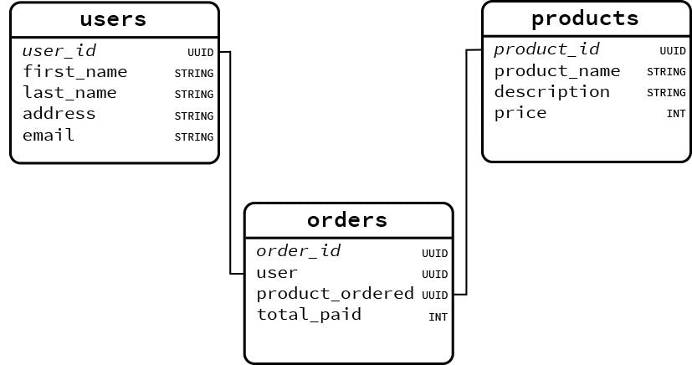
Practice
2

